Slide 1
Matrix-Vector Multiplication by MapReduce
From Rajaraman / Ullman- Ch.2
Part 1

Slide 2
Google implementation of MapReduce
created to execute very large matrix-vector multiplications
When ranking of Web pages that goes on at search engines, n is in the tens of billions.
Page Rank- iterative algorithm
Also, useful for simple (memory-based) recommender systems

Slide 3
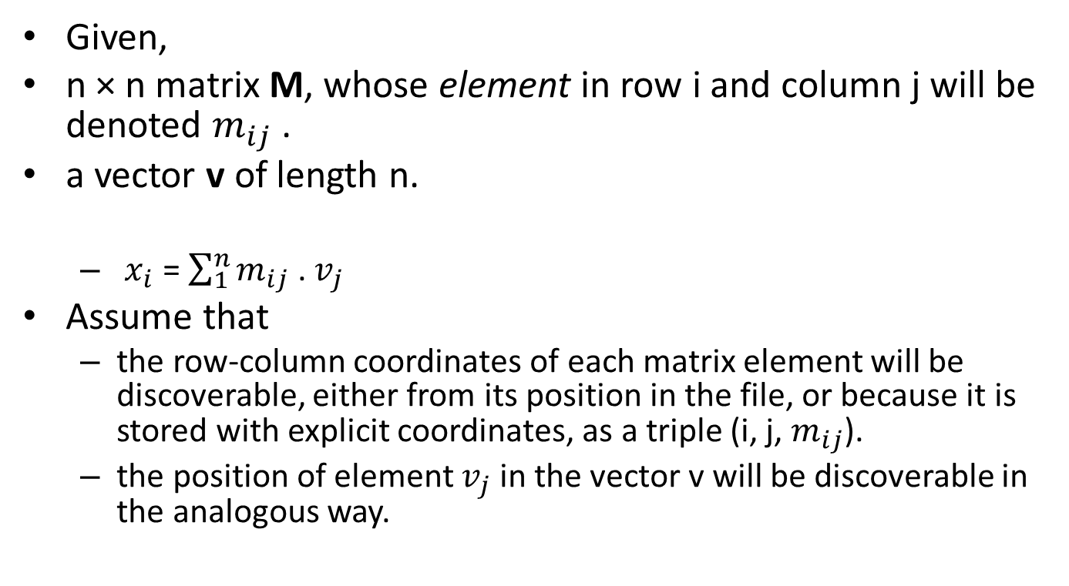
Problem Statement
Given,
n × n matrix M, whose element in row i and column j will be denoted $m_{ij}$ .
a vector v of length n.
  $x_{i}$ = $\sum_{1}^{n}{m_{ij}}$ . $v_{j}$
Assume that
  the row-column coordinates of each matrix element will be discoverable, either from its position in the file, or because it is stored with explicit coordinates, as a triple (i, j, $m_{ij}$).
  the position of element $v_{j}$ in the vector v will be discoverable in the analogous way.

Slide 4
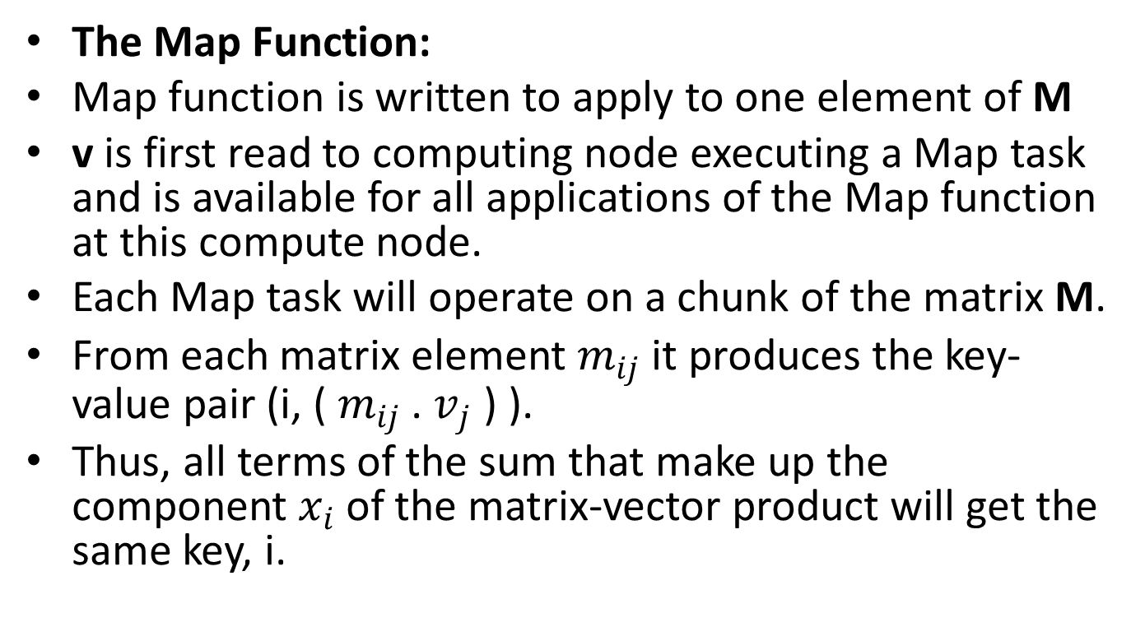
Case 1: n is large, but not so large that vector v cannot fit in main memory
The Map Function:
Map function is written to apply to one element of M
v is first read to computing node executing a Map task and is available for all applications of the Map function at this compute node.
Each Map task will operate on a chunk of the matrix M.
From each matrix element $m_{ij}$ it produces the key-value pair (i, ( $m_{ij}$ . $v_{j}$ ) ).
Thus, all terms of the sum that make up the component $x_{i}$ of the matrix-vector product will get the same key, i.

Slide 5

Case 1 Continued …
The Reduce Function:
The Reduce function simply sums all the values associated with a given key i.
The result will be a pair (i,$x_{i}$ ).

Slide 6
Case 2: n is large to fit into main memory
v should be stored in computing nodes used for the Map task
Divide the matrix into vertical stripes of equal width and divide the vector into an equal number of horizontal stripes, of the same height.
Our goal is to use enough stripes so that the portion of the vector in one stripe can fit conveniently into main memory at a compute node.

Slide 7
            Matrix M vector v
Figure 2.4: Division of a matrix and vector into five stripes
The ith stripe of the matrix multiplies only components from the ith stripe of the vector.
Divide the matrix into one file for each stripe, and do the same for the vector.
Each Map task is assigned a chunk from one of the stripes of the matrix and gets the entire
corresponding stripe of the vector.
The Map and Reduce tasks can then act exactly as was described, as case 1.

Slide 8
Recommender is one of the most popular large-scale machine learning techniques.
  Amazon
  eBay
  Facebook
  Netflix
  …

Slide 9
Two types of recommender techniques
  Collaborative Filtering
  Content Based Recommendation
Collaborative Filtering
  Model based
  Memory based
    User similarity based
    Item similarity based

Slide 10
Item-based collaborative filtering
Basic idea:
  Use the similarity between items (and not users) to make predictions
Example:
  Look for items that are similar to Item5
  Take Alice's ratings for these items to predict the rating for Item5
 | Item1 | Item2 | Item3 | Item4 | Item5
Alice | 5 | 3 | 4 | 4 | ?
User1 | 3 | 1 | 2 | 3 | 3
User2 | 4 | 3 | 4 | 3 | 5
User3 | 3 | 3 | 1 | 5 | 4
User4 | 1 | 5 | 5 | 2 | 1

Slide 11
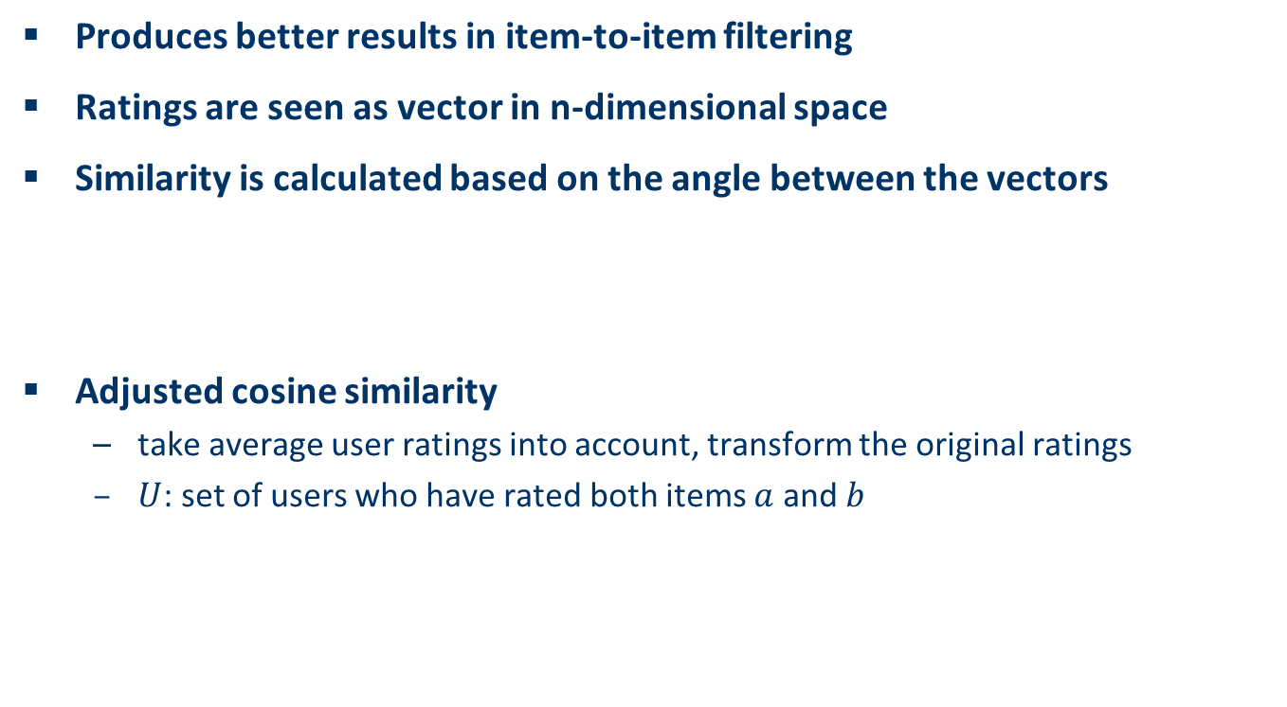
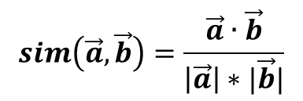
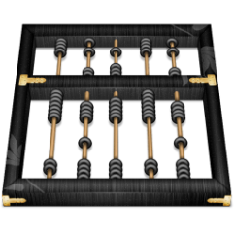
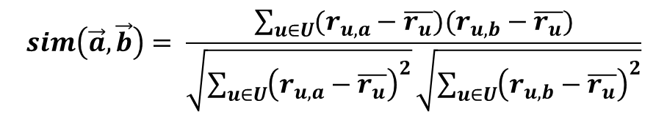
The cosine similarity measure

Slide 12
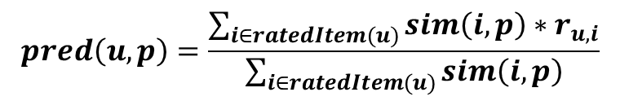
Making predictions
A common prediction function:
u –> user; i,p -> items; user has not rated item p.
Neighborhood size is typically also limited to a specific size
Not all neighbors are taken into account for the prediction
An analysis of the MovieLens dataset indicates that "in most real-world situations, a neighborhood of 20 to 50 neighbors seems reasonable" (Herlocker et al. 2002)

Slide 13
Pre-processing for item-based filtering
Item-based filtering does not solve the scalability problem itself
Pre-processing approach by Amazon.com (in 2003)
  Calculate all pair-wise item similarities in advance
  The neighborhood to be used at run-time is typically rather small, because only items are taken into account which the user has rated
  Item similarities are supposed to be more stable than user similarities
Memory requirements
  Up to N² pair-wise similarities to be memorized (N = number of items) in theory
  In practice, this is significantly lower (items with no co-ratings)
  Further reductions possible
    Minimum threshold for co-ratings
    Limit the neighborhood size (might affect recommendation accuracy)

Slide 14
Mahout’s Item-Based RS
  Apache Mahout is an open source Apache Foundation project for scalable machine learning.
  Mahout uses Map-Reduce paradigm for scalable recommendation

Slide 15
Mahout’s RS
Matrix Multiplication for Preference Prediction
1 2 3 4 5
16 | 9 | 16 | 5 | 6
9 | 30 | 19 | 3 | 2
16 | 19 | 23 | 5 | 4
5 | 3 | 5 | 10 | 20
6 | 2 | 4 | 20 | 9
0
5
5
2
0
135
251
220
60
70
1
2
3
4
5
1
2
3
4
5
Item-Item Similarity Matrix
Active User’s Preference Vector

Slide 16
As matrix math, again
Inside-out method
9
30
19
3
2
16
19
23
5
4
5
3
5
10
20
135
251
220
60
70
5
5
2

Slide 17
Page Rank Algorithm
One iteration of the PageRank algorithm involves taking an estimated Page-Rank vector v and computing the next estimate v′ by
v′ = βMv + (1 − β)e/n
β is a constant slightly less than 1, e is a vector of all 1’s, and
n is the number of nodes in the graph that transition matrix M represents.

Slide 18
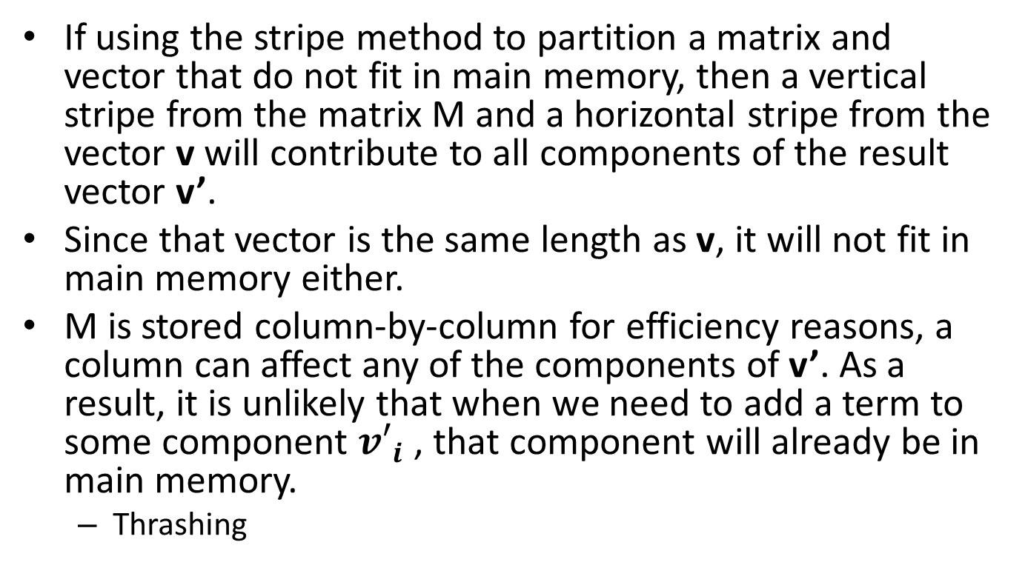
Vectors v and v’ are too large for Main Memory
If using the stripe method to partition a matrix and vector that do not fit in main memory, then a vertical stripe from the matrix M and a horizontal stripe from the vector v will contribute to all components of the result vector v’.
Since that vector is the same length as v, it will not fit in main memory either.
M is stored column-by-column for efficiency reasons, a column can affect any of the components of v’. As a result, it is unlikely that when we need to add a term to some component ${v′}_{i}$ , that component will already be in main memory.
  Thrashing

Slide 19
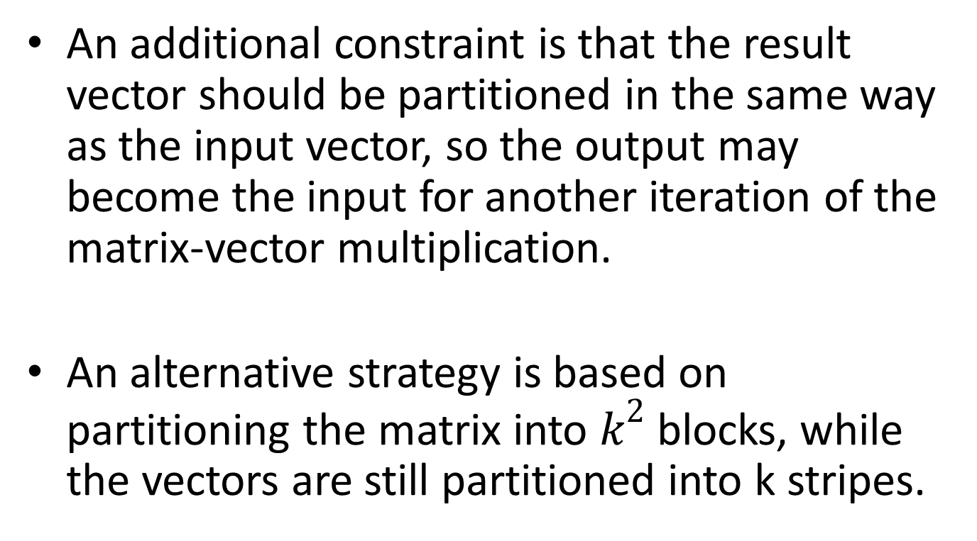
Square Blocks, instead of Slices
An additional constraint is that the result vector should be partitioned in the same way as the input vector, so the output may become the input for another iteration of the matrix-vector multiplication.
An alternative strategy is based on partitioning the matrix into $k^{2}$ blocks, while the vectors are still partitioned into k stripes.

Slide 20
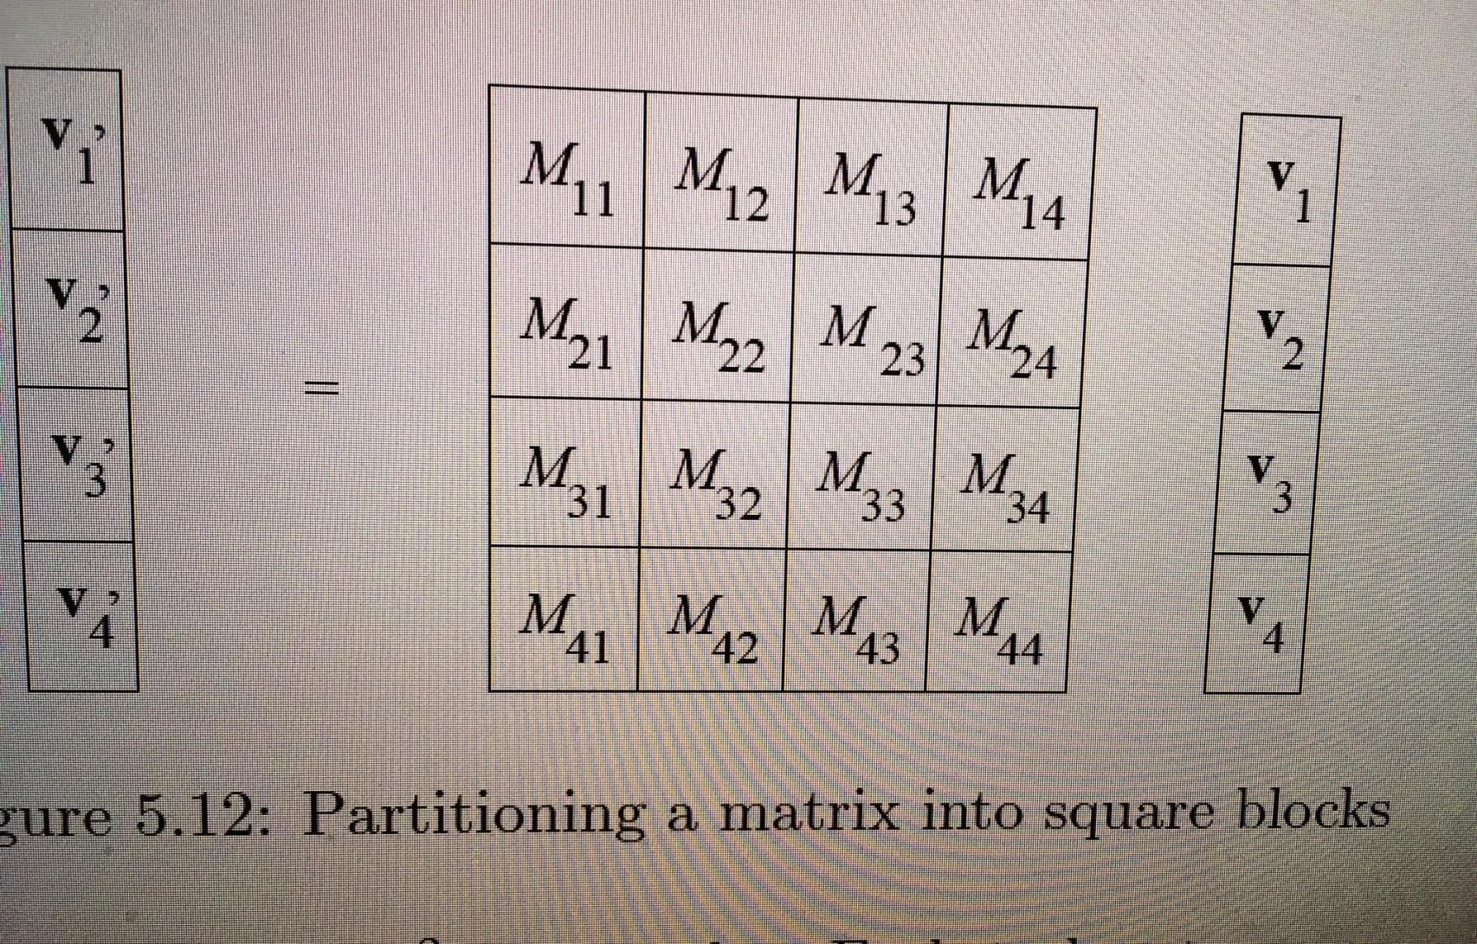
Figure from Rajaraman, Ullmann

Slide 21
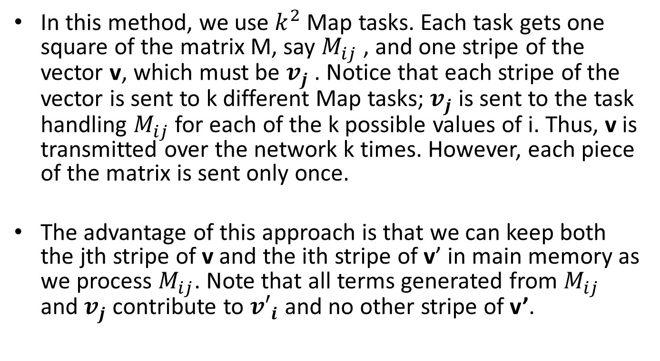
Iterative Computation- Square Blocks Method
In this method, we use $k^{2}$ Map tasks. Each task gets one square of the matrix M, say $M_{ij}$ , and one stripe of the vector v, which must be $v_{j}$ . Notice that each stripe of the vector is sent to k different Map tasks; $v_{j}$ is sent to the task handling $M_{ij}$ for each of the k possible values of i. Thus, v is transmitted over the network k times. However, each piece of the matrix is sent only once.
The advantage of this approach is that we can keep both the jth stripe of v and the ith stripe of v’ in main memory as we process $M_{ij}$. Note that all terms generated from $M_{ij}$ and $v_{j}$ contribute to ${v′}_{i}$ and no other stripe of v’.

Slide 22
Matrix-Matrix Multiplication using MapReduce
Like Natural Join Operation

Slide 23
The Alternating Least Squares (ALS) Recommender Algorithm

Slide 24
Matrix A represents a typical user-product-rating model
The algorithm tries to derive a set of latent factors (like tastes) from the user-product-rating matrix from matrix A.
So matrix X can be viewed as user-taste matrix
And matrix Y can be viewed as a product-taste
matrix

Slide 25
Objective Function
$$minimize \frac{1}{2}{|\left|A−XY^{T}\right||}^{2}$$
Only check observed ratings
$$minimize \frac{1}{2}\sum_{(i,j)∈Ω}{{(a_{{i,j}^{}}^{}−{x_{i}^{}}^{T}y_{j}^{})}^{2}}$$
If we fix X, the objective function becomes a convex. Then we can calculate the gradient to find Y
If we fix Y, we can calculate the gradient to find X

Slide 26
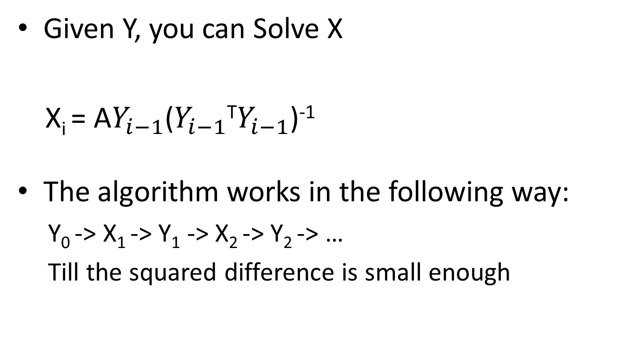
Iterative Training Algorithm
Given Y, you can Solve X
X_{i} = A$Y_{i−1}$($Y_{i−1}$^{T}$Y_{i−1}$)⁻¹
The algorithm works in the following way:
Y₀ -> X₁ -> Y₁ -> X₂ -> Y₂ -> …
Till the squared difference is small enough

